Slide 1
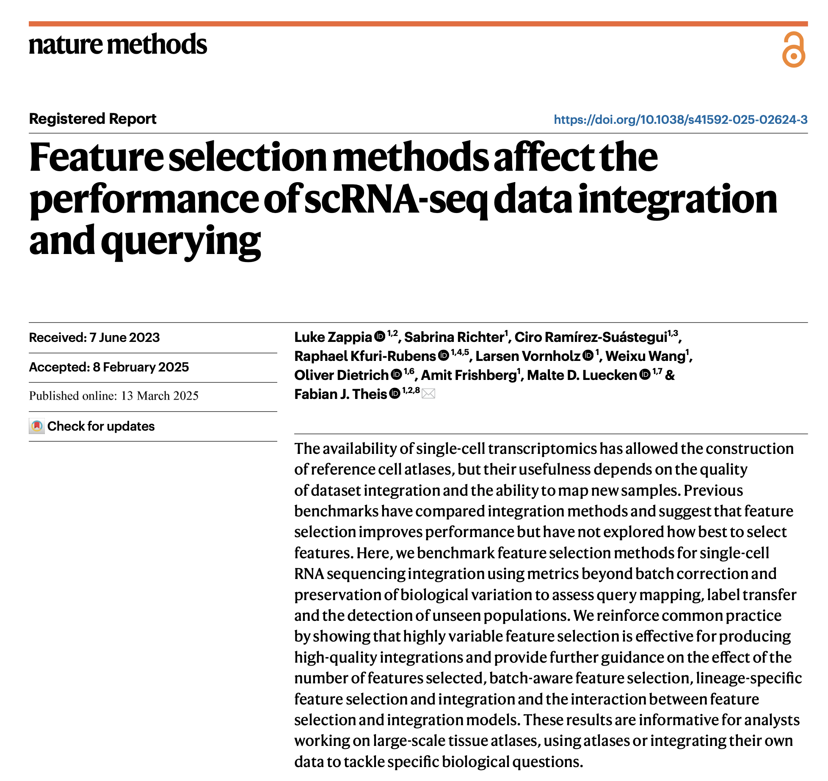
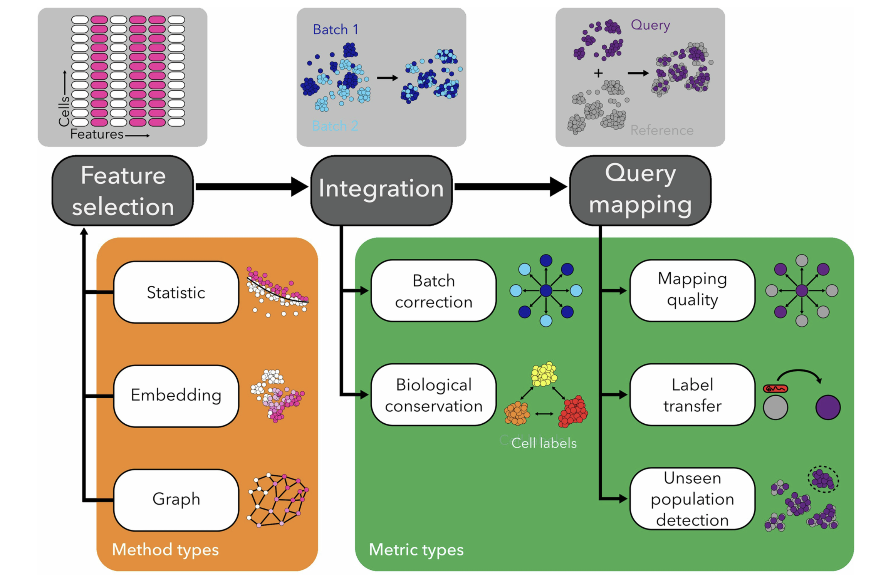
Journal club
4-1-2025
Ty Bottorff

Slide 2
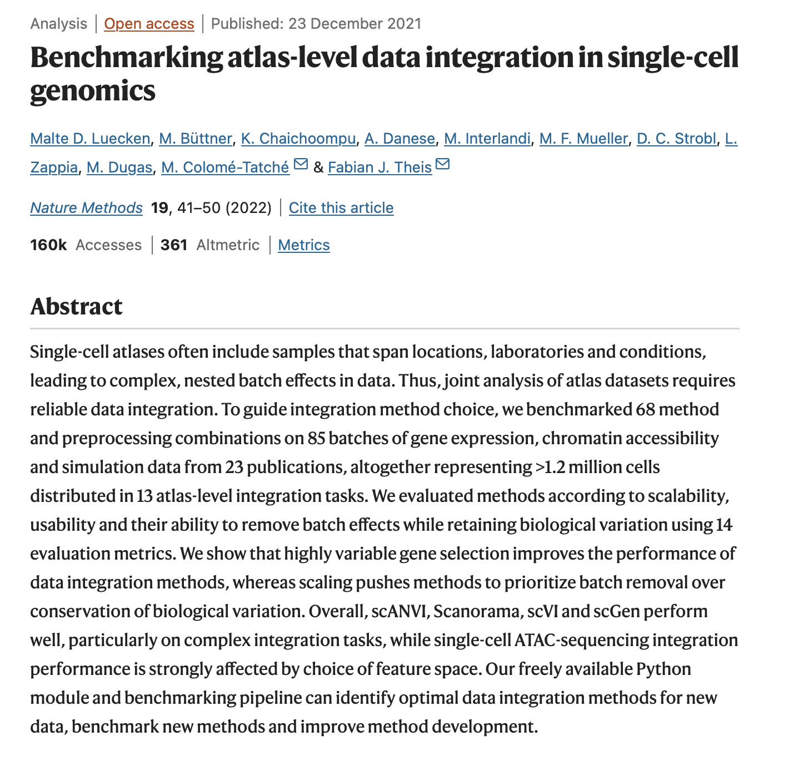
Goal: assess the impact of feature selection method on integration/mapping
Previously shown that using highly variable genes generally leads to better integrations
Other steps’ methods in scRNAseq analysis have been considered more in depth than feature selection
Important topic as all downstream steps rely on using a subset of features
Notes:
Integration meaning batch correction, mapping meaning query to reference

Slide 3
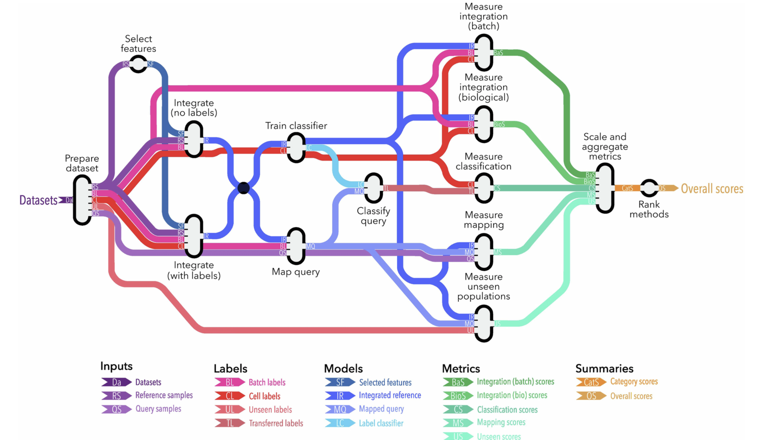
Nextflow workflow overview
Apply standard preprocessing (QC)
Split dataset into reference and query
Apply feature selection methods to reference
Use feature sets for integration (single-cell variational interference, scVI)
Map query to integrated reference using those feature sets
Use cell label classifier trained on integrated reference to transfer labels to query cells (scikit-learn)
Scale/aggregate metric scores
Rank methods after considering results from all datasets
Notes:
Standard preprocessing (QC filtering cells, labelling cells with batch/annotation labels, remove cells w/ < 100 counts or < 100 features)
Splitting dataset into reference and query samples (based on batch labels, annotations defined as unseen query removed from reference) with annotations

Slide 4
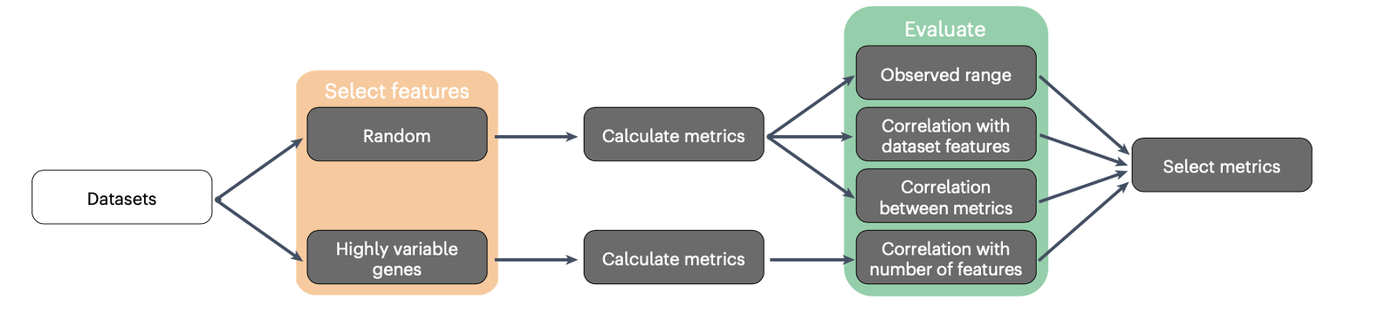
Desired features of metrics for benchmarking integrations
Non-redundant (orthogonal to other metrics)
Aren’t overly associated with technical factors
Returns scores across whole output range
Effectively measure performance
Notes:
Performance referring to categories from next slide

Slide 5
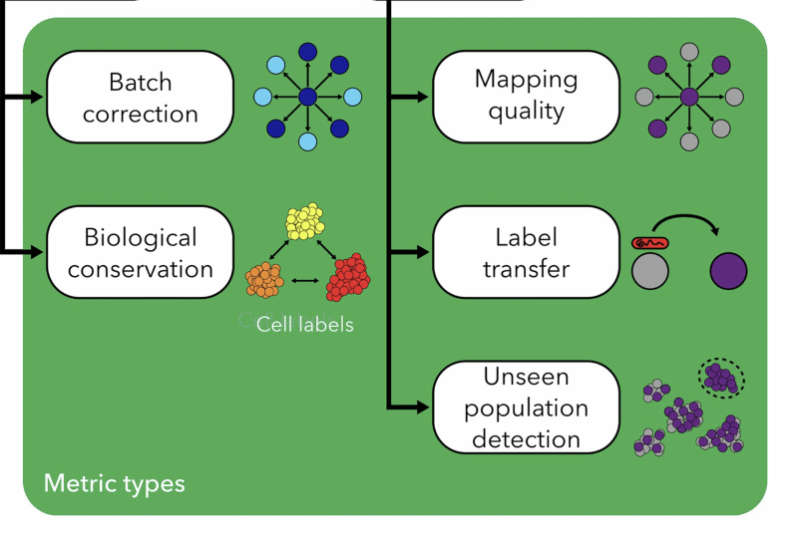
Performance categories measured by metrics
Integration
Batch: measures mixing between batches in reference
Biology: measures if biological signals (cell labels) are conserved after integration
Mapping quality: measures how well reference represents query and is able to merge it into same space
Classification (label transfer): measures how well classifier trained on reference can correctly predict labels for query cells
Unseen population prediction: measure how mapping has affected cell labels present in query but deliberately left out of reference
Notes:
Some metrics require ground truth cell label, others are unsupervised
All metrics designed so that raw score of 0 is worst performance and 1 is best
Batch integration: cells of same cell type should be mixed and neighborhoods should be equally likely to contain cells from any batch
Mapping quality: cell types present in both reference/query should be mixed as should batches within query. Biology within query should be preserved
Unseen population prediction: focus on novel biology in query by measuring how mapping has affected cell labels present in query but deliberately left out in reference (should be maintained as separate populations but integration that does not properly capture variation may merge them with other labels)

Slide 6
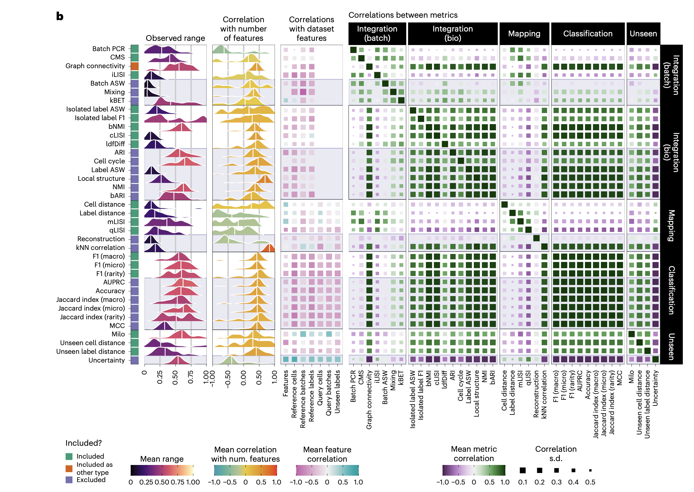
Choosing metrics to use for benchmarking integrations
Common reasons for excluding metrics
Limited (observed) effective range
Correlated with other metrics in same type (redundant)
Inconsistent between datasets
Can’t be calculated for simulated datasets (cell cycle)
Most non-mapping metrics positively correlate with number of features
Notes:
Mapping metrics are generally negatively correlated with # of features, maybe smaller feature sets produce noisier integrations, less-precise query mapping
More complex datasets generally result in lower scores for all metrics
Metric definitions:
Batch PCR (principal component regression): how much of variance in dataset can be explained by batch labels
CMS (cell-specific mixing score): tests for batch effects within neighborhood of each cell
Label ASW (average silhouette width): measures relationship between distances between cells within a cluster and distances between cells in that cluster and other clusters (clusters = cell label)
F1 score: harmonic mean of precision (true positive rate, proportion of identified labels truly positive) and recall (proportion of true labels identified)
Milo: identifies cell neighborhoods that show differential abundance associated with a covariate

Slide 7
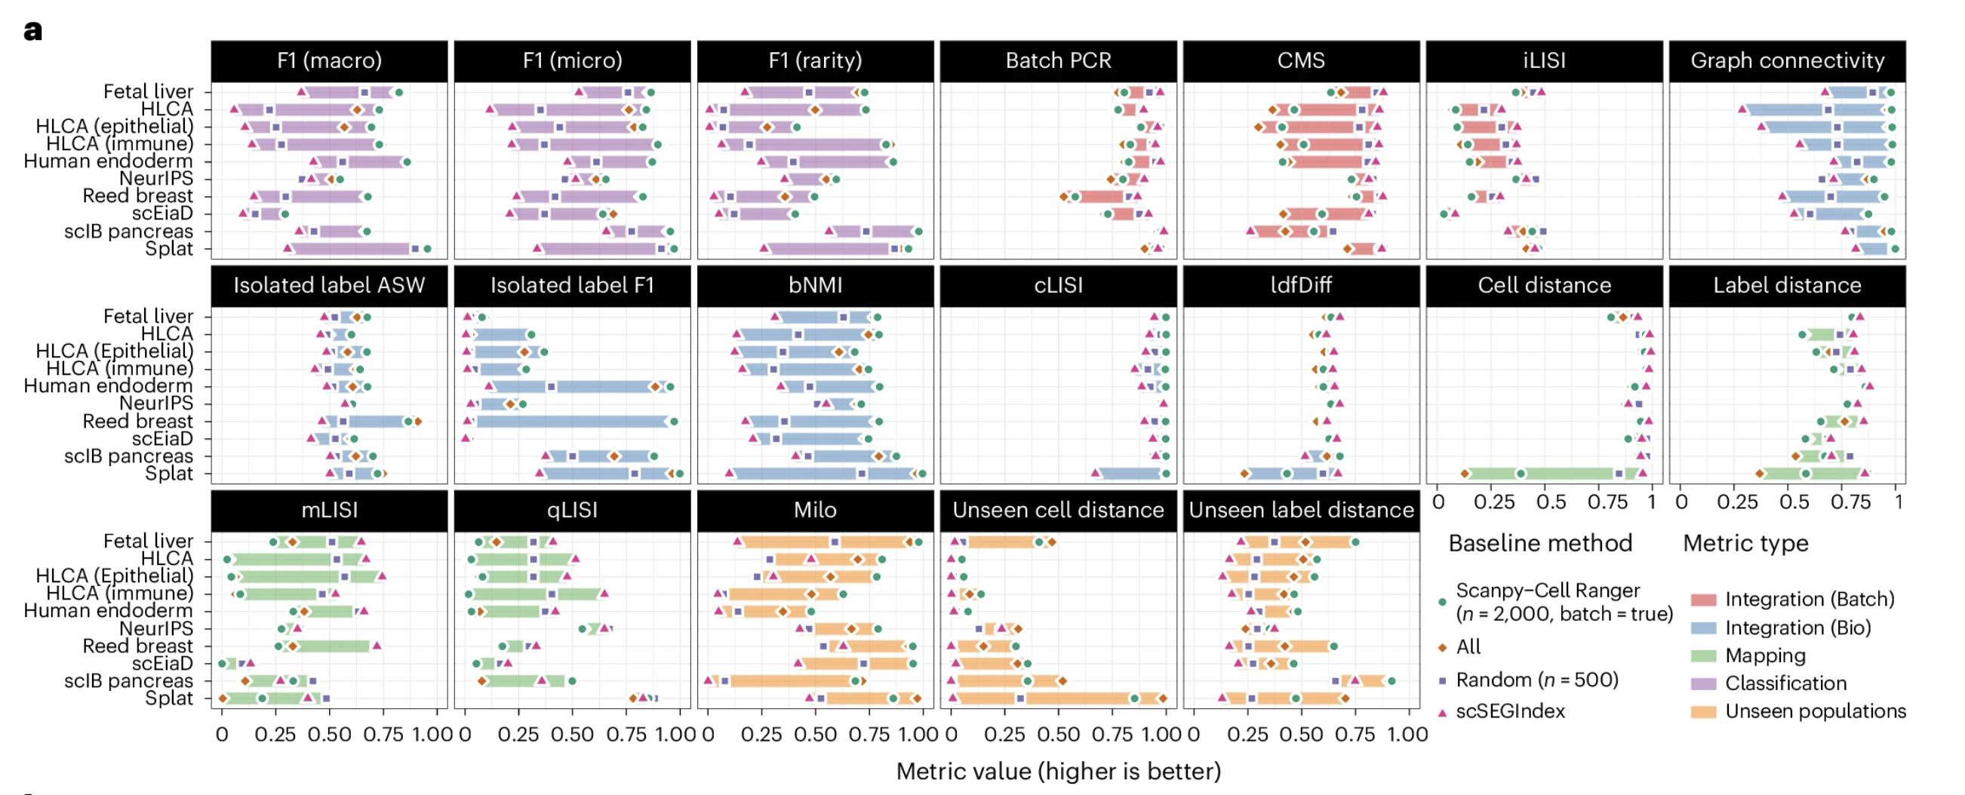
Scaling metric values to have same range for each dataset
Notes:
This is needed because individual metrics have different effective ranges/interact differently with datasets
Use 4 baseline methods (all features, 2k HVGs, 500 randomly selected genes, 200 stably expressed genes as negative controls that shouldn’t capture signal), integrate each dataset using features
Can see that stably expressed feature set generally has lower metric scores (not true for batch integration though interestingly…)

Slide 8
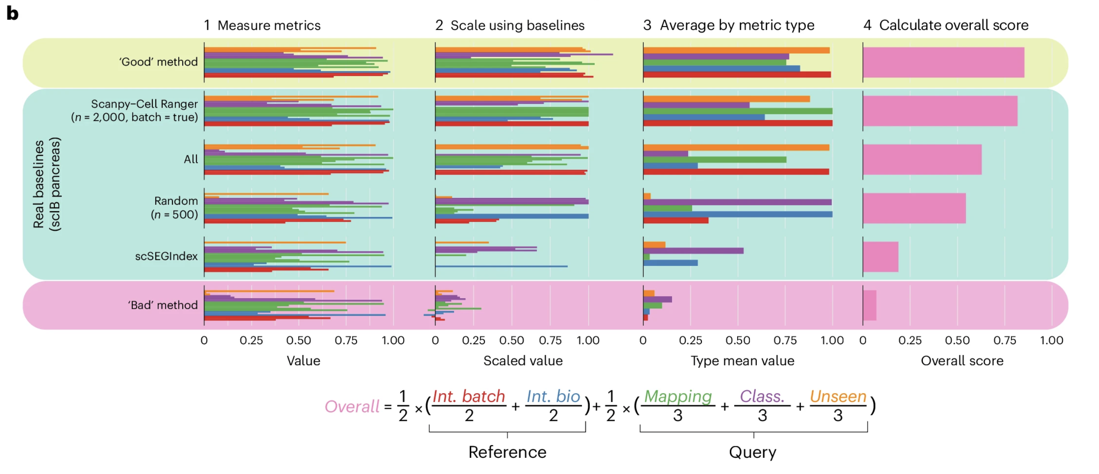
Weighted mean of task scores for overall method score
hypothetical
hypothetical
Final overall score (weighted mean):
Notes:
Absolute metric values are of little interest, the relative performance of methods and the aggregation across metrics are more informative
Even with all raw metric scores being adjusted to be 0-1, they still had different dynamic ranges (can vary by dataset) before this scaling
Scale metric scores using baseline ranges (relative to min and max of baseline scores), aggregate by taking mean/category
Weighted mean of scores using formula at bottom
Theoretical “Good” and ”Bad” methods illustrate behavior of methods that generally perform well/poorly across metric types (in contrast to baselines that score highly on some and lowly on others), scaled scores > 1 (”Good”) or < 0 (”Bad”) possible if method performs better/worse than all baselines (respectively)
Again can see that using stably expressed features is pretty bad
Here just using 1 dataset as an example (scIB), do this at the dataset level (per dataset)

Slide 9
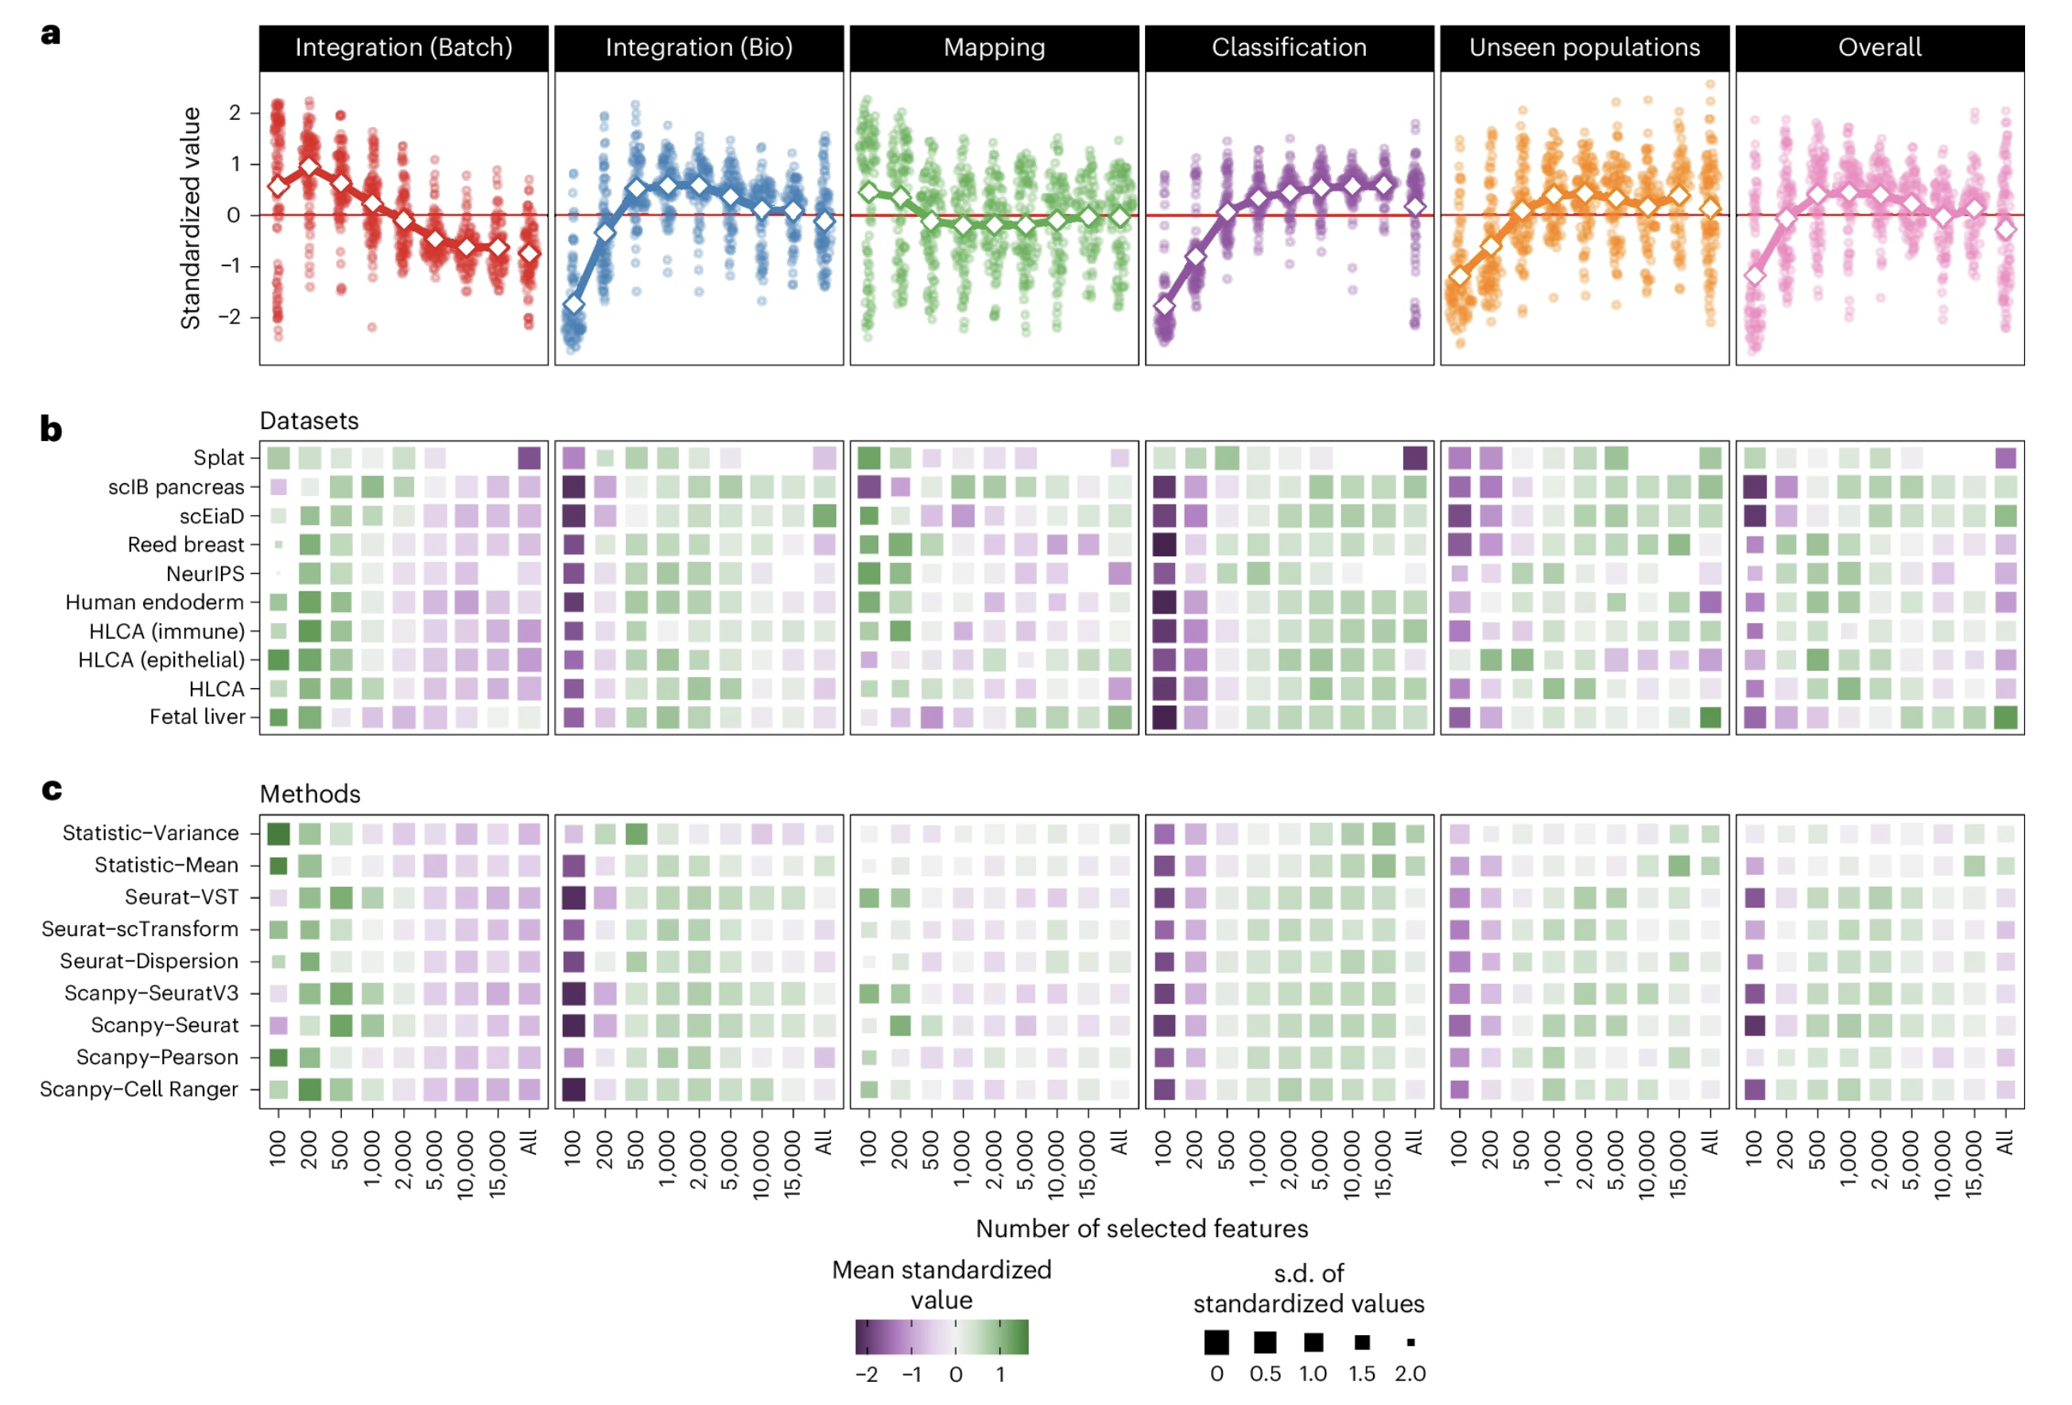
Effect of the number of selected features
Notes:
For context, default # HVGs typically 2000, and this is what they use going forward (high scores generally)
A) y-axis are Z-scores for each dataset and method combination
Results:
- batch integration score highest with smaller feature sets, similar but less extreme for mapping (<= 500 features)
- classification/unseen population show opposite trend (more features better but > 500 sufficient)
- biological integration good with mid range, bad with few, ok with many
Patterns reflect that better batch correction comes at expense of creating ”noisy” integrated embedding with less separation b/w cell types (so lower bio integration?)
There is variation depending on the dataset/method in these results, like simulated splat dataset needing less features to capture variation but scIB pancreas dataset needing more given real data complexity and has several technologies that present integration challenge
# of features at which additional signal saturates varies by dataset (function of biological/technical diversity)

Slide 10
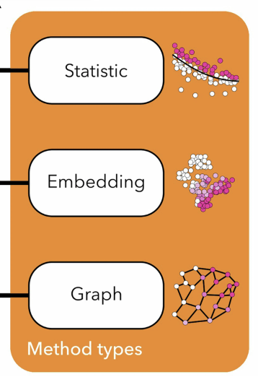
Types of feature selection methods
Simple control
All features
Random sets (5 with different seeds)
Reference points
Excess variability (HVGs)
Most common approach (scanpy/Seurat)
Assume that excess variability beyond expectation (controlling for mean expression) results from differences in gene expression between cell populations/states and not from noise
Other statistical features
Highest mean expression
Excess negative correlations with other features using permutation-based approach (Anticor)
Excess zero counts for mean expression (NBumi)
Models
Fit distributional model to dataset, select features that significantly differ from fitted model
scTransform (Seurat, regularized negative binomial distribution), analytic Pearson residuals (scanpy)
Embedding-based (dimensionality reduction): look for features that vary across an embedding rather than in original feature space
Graph-based: based on nearest-neighbor graph of cells
Supervised: marker genes selected using Wilcoxon rank-sum test (scanpy)
Stable expression
Opposite of HVGs
Negative control
scSEGIndex method
Notes:
We focused on unsupervised methods and other supervised techniques may produce more stable results; however, supervised feature selection only applies when cell labels are available, typically not the case before integration
Expect that real method-selected features will → higher performance than simple controls (all/random)
Excess variability
- calculating variance of each feature and selecting highest neglects mean-variance relationship (lowly-expressed features more variable generally due to greater effect of sampling noise)
- mean-variance relationship dealt with by fitting curve between normalized mean expression of each feature and squared coefficient of variation → select features above trend
- Seurat excess variability feature selection methods: highest dispersion, MVP (binned version of prior), VST (current default, variance stabilizing transformation, fits LOESS line to relationship between log mean and log variance for each gene, standardize feature values with fit then select features with highest standardized variances)
- scanpy: Python implementations of 3 HVG selection methods from other tools (Seurat MVP, Seurat VST, CellRanger ~ Seurat MVP)
Anticor rationale: genes essential to a cell type’s identity will be expressed in some types and not others (negatively correlated with others’ markers)
NBumi rationale: features important for a cell type should be highly expressed in some types but not others
Stable expression methods: negative control (should perform poorly for integration as they shouldn’t capture technical noise or biological signal)
- scSEGIndex fits gamma-Gaussian mixture model to each feature

Slide 11
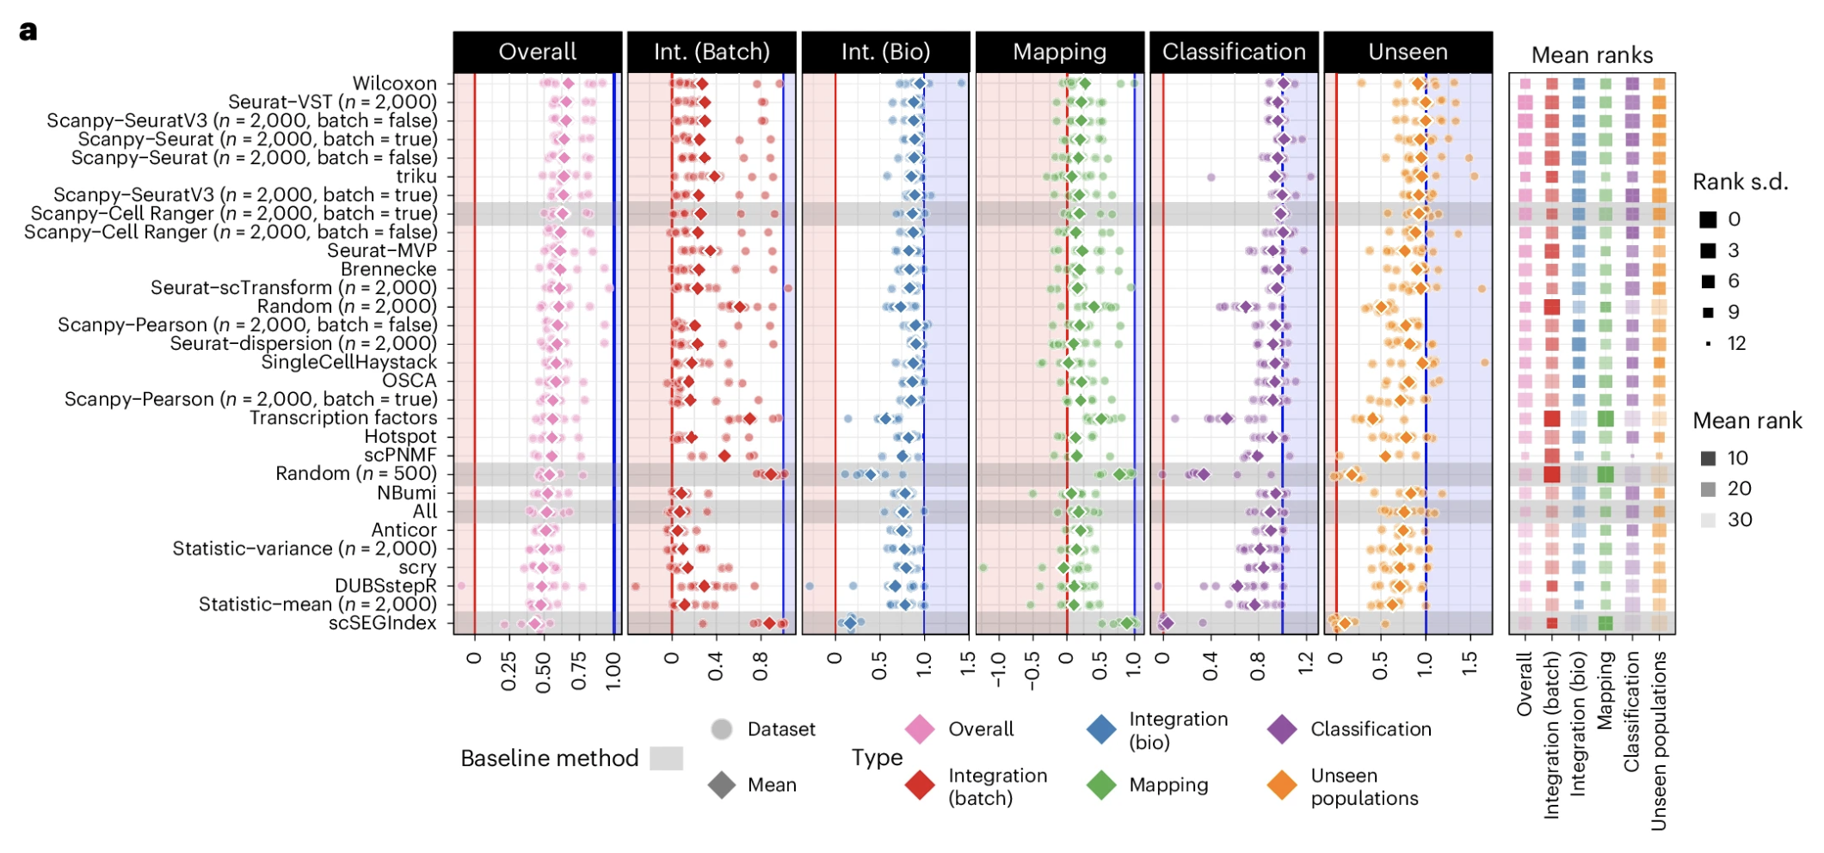
Summary of method performances by metric type
Notes:
Points show score for individual datasets, diamonds show means
Methods sorted by overall score
Baseline reference methods shown in gray shading
Red/blue shades show scores < or > baseline 0-1 range (respectively)
Average rankings for each metric type shown on right
Wilcoxon method (only method to select features using cell labels) has highest overall score but is more variable across datasets than other top-performing methods
Seurat-VST and other HVG methods perform best and are less variable across datasets
Triku also performs well but has some bias towards batch correction over conserving biological variation

Slide 12
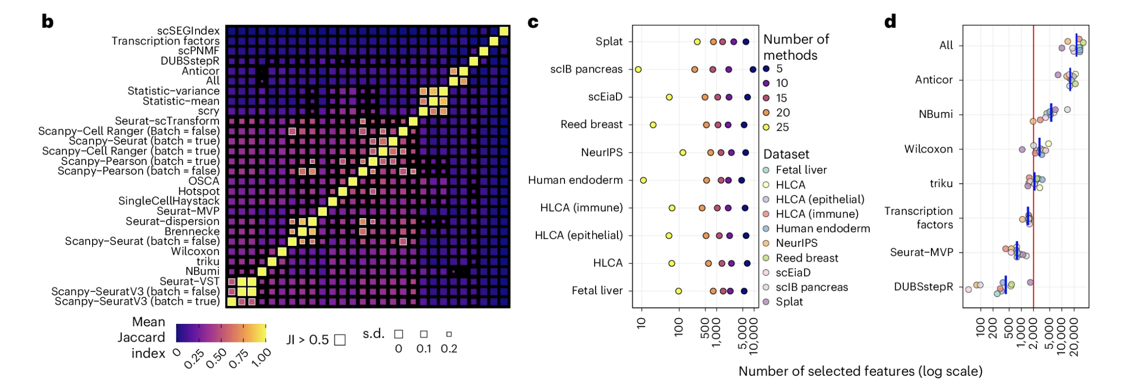
Overlap of features selected by different methods
Notes:
Some overlap in selected features for most methods, but Jaccard index rarely > 0.5 unless they are different implementations of same method (like Seurat-VST and scanpy-SeuratV3)
B) Heatmap showing mean Jaccard index between feature sets selected by different methods (excluding random sets)
Despite lack of high overlap between feature sets, there is a core set of features selected by most methods, between 500-1000 features selected by > 20 methods for most datasets, so a subset of features clearly contains information for a dataset that should be crucial for effective integration and query mapping. Remaining features less likely to be shared between methods may result from redundancy in gene expression (several genes providing info about same process)
C) Number of features (log scale) selected by at least n methods for each dataset
Multiple “good” feature sets exist for a dataset, low overlap b/w feature sets b/w similarly performing methods

Slide 13
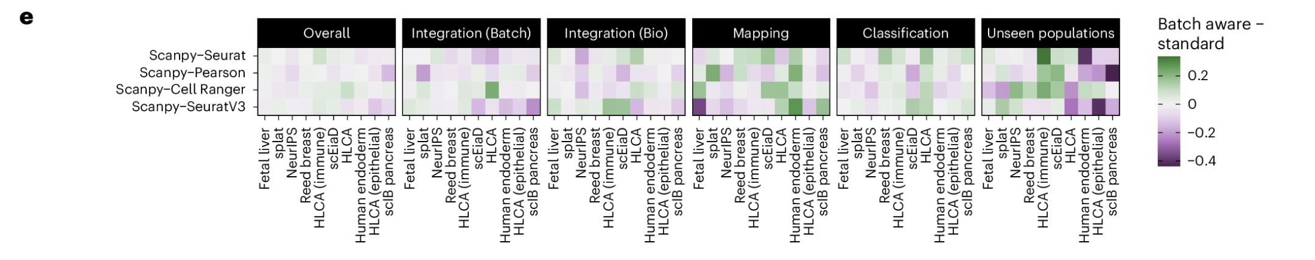
Dynamic and batch-aware methods
Notes:
Anticor selects majority of features and unexpectedly performs similar to using all features
DUBStepR selects very few features and has low overall performance, but it does well on biological integration (so it selects informative features but not enough to correct batch effects)
Some dynamic methods work well (Wilcoxon, triku, Seurat-MVP) and they tend to select ~2000
D) Number of features selected by different methods. Blue bars are means. Only methods that automatically determine the number of features are shown. Red line shows 2000 (what most other methods were set to)
Can also select features for each batch and then choose features selected for most batches (rationale being to avoid features that vary by batch but not biological states within a batch), so they tried batch-aware variants of the scanpy methods. No consistent improvement across datasets/method type
While we do not rule out batch-aware feature selection as a useful approach, we cannot identify a scenario where it is consistently more effective than selecting features across batches

Slide 14
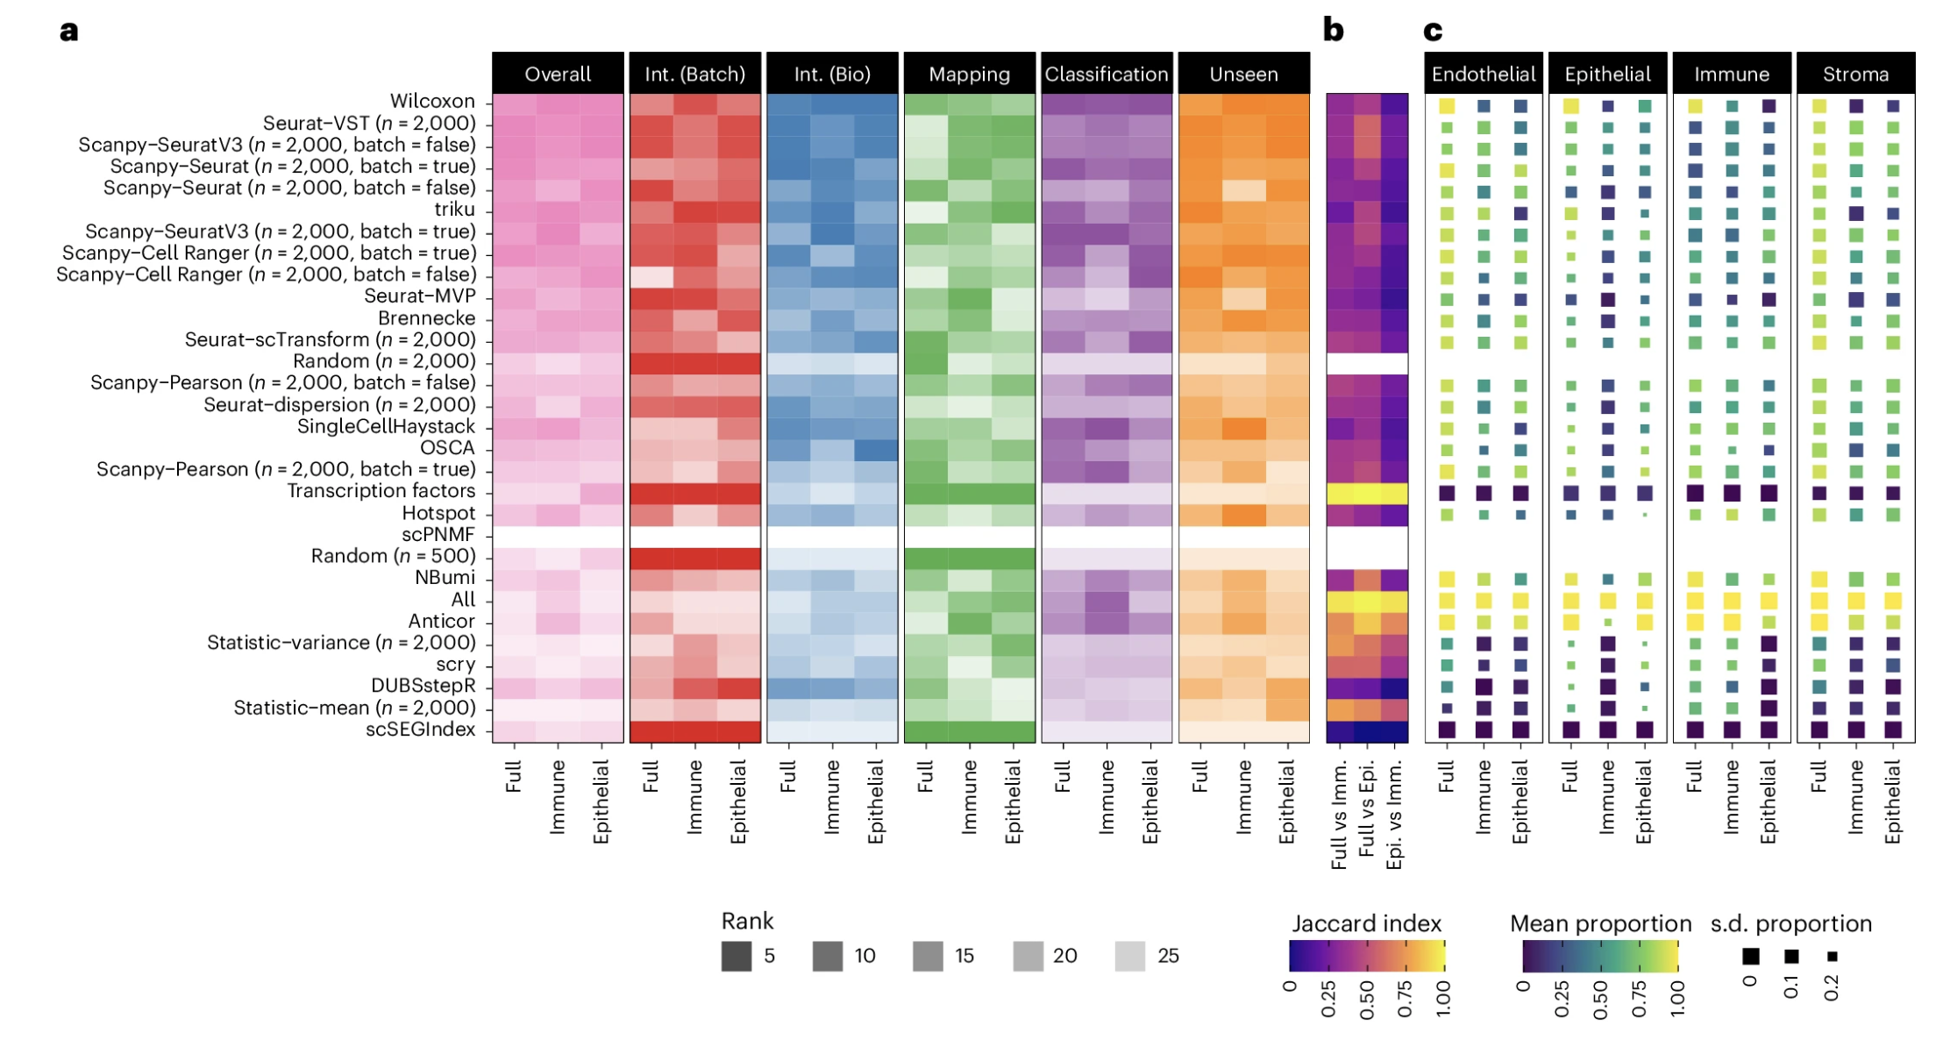
In large-scale integrations, subsetting to specific lineages doesn’t improve performance
HLCA subsets
Notes:
Question: in large-scale integrations, is it better to integrate across full diversity of cell states or to limit the complexity by subsetting to specific lineages/conditions (motivation being to select more features specific for cell types in that subset)? They investigate this Q by looking at subsets of the HLCA dataset
Rankings for all methods for each HLCA subset, in general they follow trends observed when considering all datasets (don’t see any methods that consistently rank higher on lineage subset vs. full dataset)
Jaccard index between selected features (to see if similar rankings result from selecting similar feature sets), overlap not higher than seen between all datasets
Consider published marker gene sets for the HLCA and calculate proportion of these markers selected by each method on each dataset subset. In most cases, relatively few calculated markers are selected (maybe due to redundancy of information contained by related genes and differences in which features are prioritized for selection vs. marker detection)

Slide 15
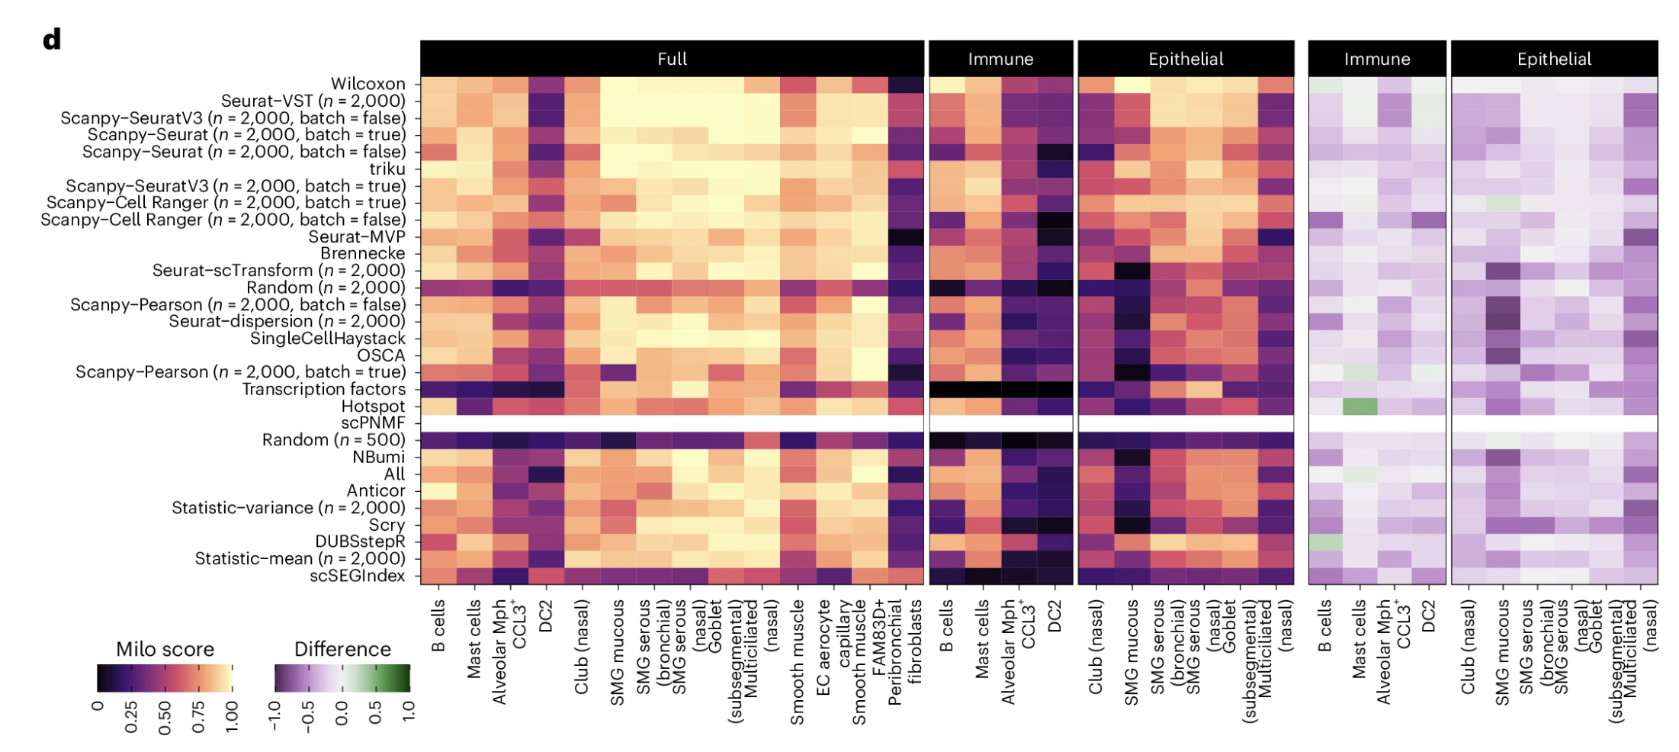
Specific look at unseen population detection (not better with HLCA subsets)
Notes:
To consider one area in more detail, we calculated Milo scores for individual unseen labels, allowing us to see if an unseen cell type is easier to distinguish in a whole-tissue or lineage-specific atlas
Clear trend of lower scores on the lineage subsets, by providing more diverse input data to the integration model it learns more of the possible cell space and can, therefore, better distinguish new cell populations

Slide 16
Takeaways
Highly variable genes still best general approach for feature selection
Marker-based selection may be worth it if you have prior knowledge (well-defined cell types w/ good markers)
Seurat-VST/scanpy-SeuratV3 top-ranked method
Works well across integration methods
~2,000 features gives good performance, but optimal # will vary with dataset/goal (good to tune this dynamically)
< 500 may improve batch correction but hurts preservation of biological signal
> 2,000 may be needed to detect unseen populations in query datasets
> 5,000 may even reduce query performance
Multiple “good” feature sets exist for a dataset, low overlap b/w feature sets b/w similarly performing methods
Batch-aware feature selection methods aren’t consistently more effective, if there are strong batch effects, focus on good integration rather than changes to feature selection
Lineage-specific feature selections also don’t show benefit (integrating all lineages is better, more diverse reference improves query selection)
Notes:
reinforces common practice and recommendations from previous benchmarks
Label-guided marker genes (Wilcoxon) also performed well but were more variable across datasets
We focused on unsupervised methods and other supervised techniques may produce more stable results; however, supervised feature selection only applies when cell labels are available, typically not the case before integration

Slide 17
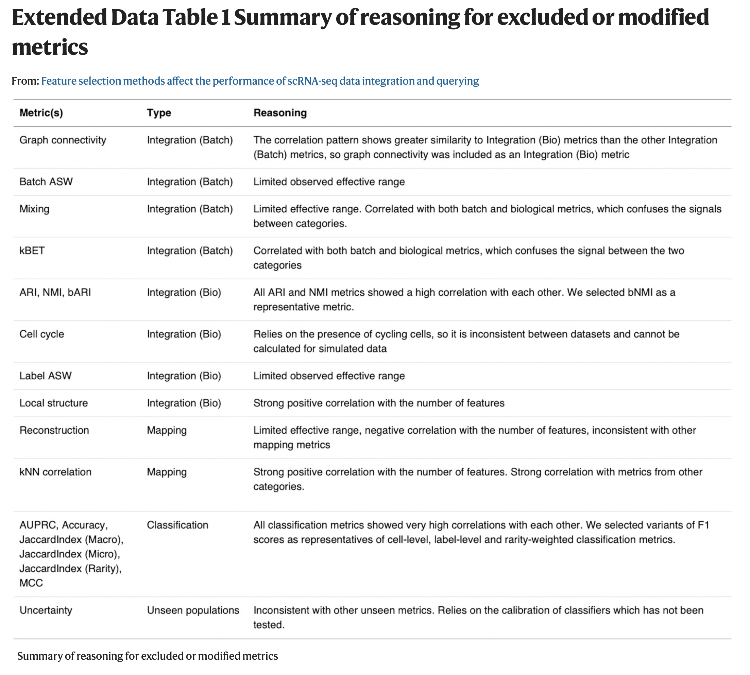
Reasons for excluding metrics

Slide 18
Datasets analyzed
scIB pancreas
Batches were different technologies
NeurIPS 2021
Reed breast
Batches were donors
Human endoderm
Human Lung Cell Atlas
HLCA (immune subset)
HLCA (epithelial subset)
splat
Simulated
Scenario: tissue measured with 3 technologies (2 batches/tech) with 2 conditions
Notes:
We selected datasets representing different scenarios (tissues, technologies and developmental stages) where integration is a critical analysis step, including smaller-scale datasets and larger atlases
We chose query batches by selecting batches with shared characteristics different from the remaining samples, such as technology, time point or location
The unseen populations removed from the reference were chosen by looking for labels enriched in the query batches and selecting labels presenting different challenges, such as rare or perturbed cells. For each dataset, we use the cell labels assigned by the original authors

Slide 19
Concerns brought up in peer review
Should vary number of features w/ same method of feature selection
“optimal” feature set may vary depending on cell types/tissues present as well as on sequencing technology, should use established atlases to ask how cell type/tissue affects what optimal features are
Need to know ground truth for evaluating metrics, so should use simulated datasets where ground truth is known
How many random feature sets were chosen as a null? Random feature set should be matched for gene expression distributions, sequence-ability to be a fair null comparison
Focus too much on droplet-based chemistry (especially as publicly available data for meta analyses aren’t all droplet-based)

